Slide 1
HNC3CI
Elements and Principles of Design

Slide 2
Elements and Principles of Design.
There are four ELEMENTS OF DESIGN:
    Line
    Shape
    Texture
    Colour
And there are five PRINCIPLES OF DESIGN:
    Balance
    Proportion
    Rhythm
    Emphasis
    Harmony

Slide 3
Element of Design: Line
Line refers to an elongated mark that connects two or more points.
Line in fashion can be created by the structure or decorative features of a garment. Structural lines are created by the structure of the garment. For example, the seam lines that are used to hold the garment together create lines. Decorative lines are created for visual appeal, but unlike structural lines, they are not necessary for garment to stay together. Trims and line patterns in fabric are examples of decorative lines.
Line in fashion is important because line affects how someone sees a fashion. Our eyes follow lines, and eyes can be lead up or down or side to side or around a garment.
Lines have direction (vertical, horizontal, diagonal, curvy, jagged) and weight (thick, thin). The direction and weight of a line can affect how a garment looks on a body.
Wise selection of lines can flatter the wearer’s appearance.

Slide 4
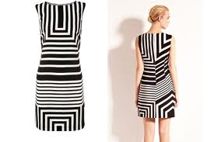
Line: Structural versus Decorative Lines
This garment has both structural and decorative lines. Structural lines are created by the seams. You can see a good example of a seam line running down the centre back of the dress. Can you see the diamond-shaped seam lines on the front of the dress that make a diagaonal pattern? The diagaonal lines created by the seams are also structural. These structural lines hold the garment together. The stripes on the fabric itself are decorative lines. Imagine how different this dress would look made out of solid coloured fabric.

Slide 5
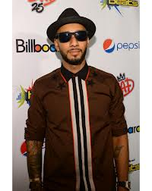
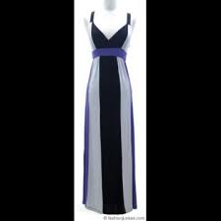
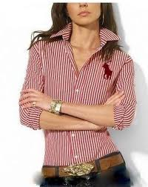
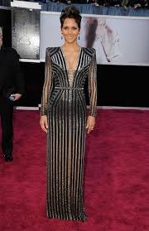
Line: Vertical Direction
The above photos all have vertical lines. Notice the difference in the weight of the lines. Some of the vertical lines are thin, while other vertical lines are much wider. A thin vertical line looks longer than a thick vertical line. Vertical lines are formal, dignified, conservative.
Vertical lines lead the eye up and down the garment. Use these lines where you want to look taller because they reinforce length, height, and narrowness.

Slide 6
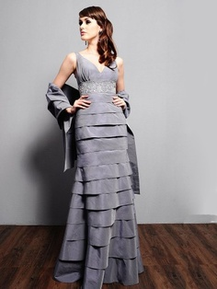
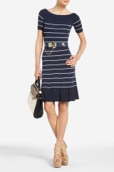
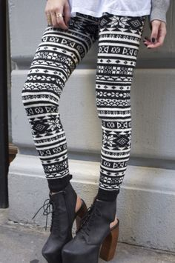
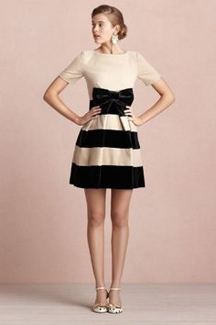
Line: Horizontal Direction
The above photos all have horizontal lines. Notice the difference in the weight of the lines. Some of the horizontal lines are thin, like in two centre photos, while the other two photos have much wider horizontal lines. A thin horizontal line looks less wide than a thick horizontal line.
Horizontal lines lead the eye across the garment. Use these lines where you want to look wider because they reinforce width and add bulk.

Slide 7
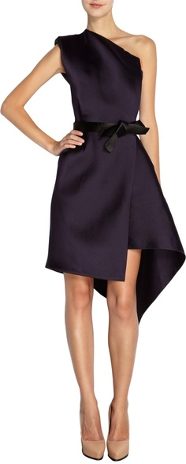
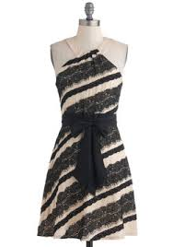
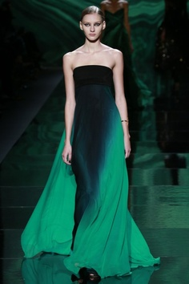
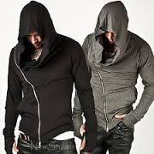
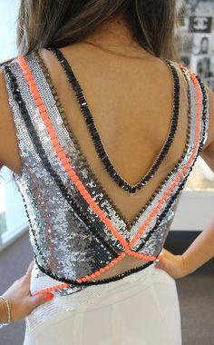
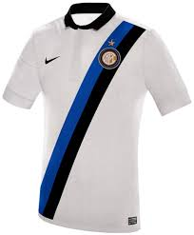
Line: Diagonal Direction
The above photos all have diagonal lines. Diagonal lines hold the eye’s attention longer than horizontal or vertical lines. They create the illusion of activity, excitement, drama, and motion. Diagonal lines are often found in v-necks, open collars, ties, stripes, flared skirts or pants, zippers, shoes with criss-cross straps, etcetera.
Diagonal lines draw the eye’s attention to where they are used. Use these lines to add emphasis to an area of the body, or to add interest to a look.

Slide 8
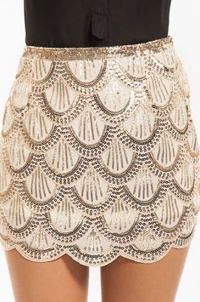
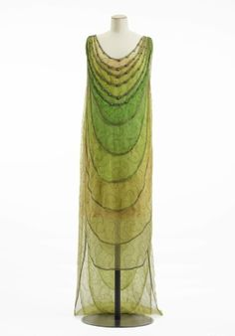
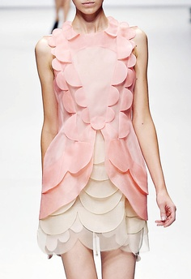
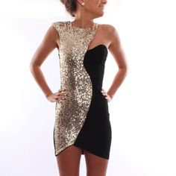
Line: Curvy Shape
The above photos all have curvy lines. Curvy lines hold the eye’s attention longer than straight lines. They create a gentle, romantic, soft, casual, feminine, graceful, sensual illusion. Curvy lines are often found in necklines, bows, lapels, sleeves, ruffles, skirts, and gathers.
Curvy lines lead the eye around the garment. Curvy lines can increase, emphasize, or reinforce body curves. They can counter angular body areas.

Slide 9
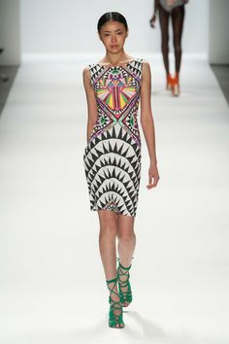
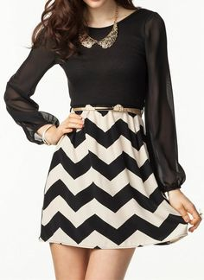
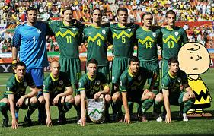
Line: Jagged Shape
The above photos all have jagged lines. Jagged lines create bold interest for the eye. They suggest the illusion of excitement, drama, motion, and confusion. Jagged lines are often featured in the patterns of fabrics or in the design of graphics and logos.
Jagged lines draw the eye’s attention to where they are used. Uses these lines to add emphasis to an area of the body, or to add interest to a look.

Slide 10
Element of Design: Shape
Shape refers to the silhouette of a garment.
There are basic shapes for women’s and men’s fashions. Popular shapes in fashion change over time.
Shape or silhouette in fashion is important because it affects how someone sees a fashion. Our eyes perceive shapes, which have an impact on how the garment is perceived.
Wise selection of shapes can flatter the wearer’s appearance.

Slide 11
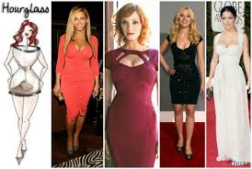
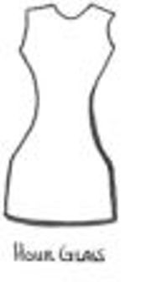
Shape: Hourglass
The above photos show the hourglass silhouette, a popular shape for women’s fashions. This fashion shape shows the bust and hip at approximately the same width, while the waist is narrower.
The hourglass shape draw the eye’s attention to the curves of a woman’s body. Use this shape to draw attention to the natural shape of a woman’s body.

Slide 12
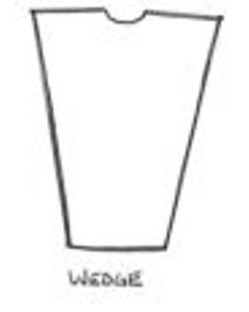
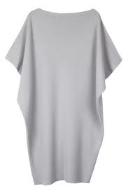
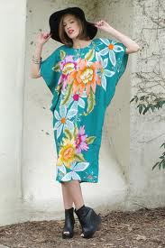
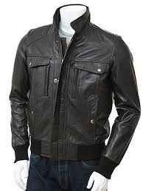
Shape: Wedge
The above photos show the wedge silhouette, a popular shape for both women’s and men’s fashions. This fashion shape shows width at the shoulders, while the garment narrows in at the bottom.
The wedge shape draw the eye’s attention to the shoulder area. Use this silhouette to make shoulders appear broader.

Slide 13
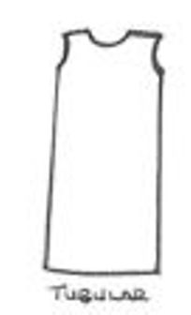
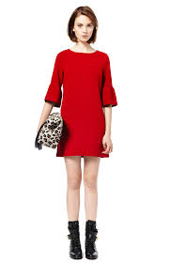
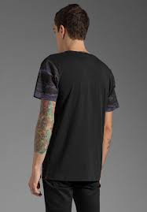
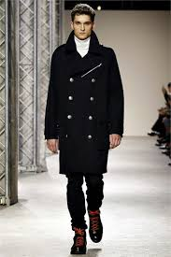
Shape: Tubular
The above photos show the tubular silhouette, a popular shape for both women’s and men’s fashions. This fashion shape shows the shoulder, waist, and hip with little definition. Tubular shaped garments do not cling to the body.
The tubular shape draw the eye’s attention up and down the length of the body. Use this shape to smooth out the body’s lines.

Slide 14
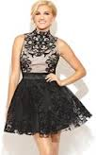
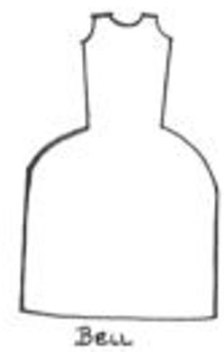
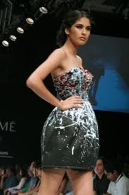
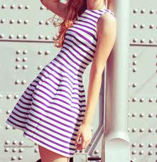
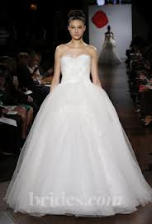
Shape: Bell
The above photos show the bell silhouette, a popular shape for women’s fashions. This fashion shape shows a fitted top, with a full, bell-shaped skirt.
The bell shape draw the eye’s attention to the waist and hip area.

Slide 15
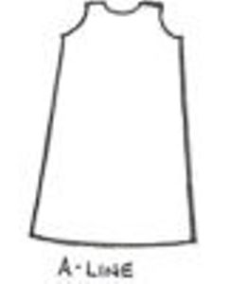
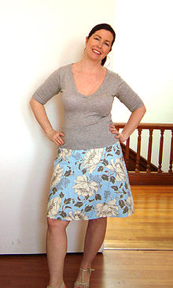
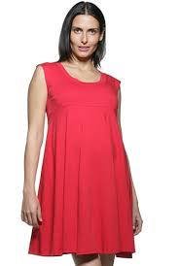
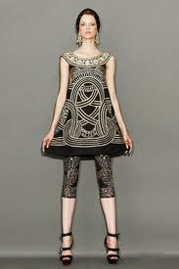
Shape: A-Line
The above photos show the A-Line silhouette, a popular shape for women’s fashions, usually dresses or skirts. Theses fashions resemble the shape of the capital letter A. This fashion shape shows a garment that is narrow at the top which broadens out toward the bottom.
The A-Line is not a fitted shape, and it flatters all figures. It is often used for summery, flirty garments. Use this style to smooth out the body’s lines.

Slide 16
Element of Design: Texture
Texture refers to the surface quality of goods.
Fabric can have a variety of textures, all of which can affect the look of a garment or fashion accessory. The weave and texture of a fabric has an impact on the way it drapes, which, in turn, affects the way a garment looks when it is worn.
Texture can be used all over the garment or for embellishment. All-over texture refers to the weave of the garment’s main fabric. For example, a sweater made with thick, heavy yarn has a chunky, bulky texture. Embellisments can create texture for garments too. For example a top may have a sequined, sparkly area that looks different from the rest of the garment.
When coming up with outfits, people often mix textures. For example, a tweed jacket could be paired with a skinny jean, or textured pants might be paired with a crisp shirt.
Wise selection of textures can flatter the wearer’s appearance. Some textures create the illusion of added weight, such as bulky or shiny fabrics.

Slide 17
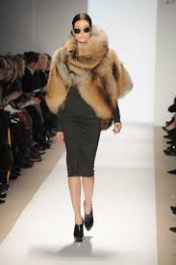
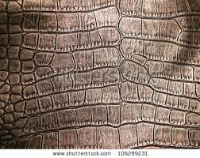
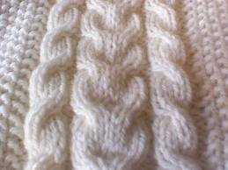
Texture: All-Over Garment
The above photos show some examples of popular textures. Entire garments can be made out natural or synthetic wool, fur, or leather.

Slide 18
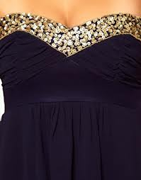
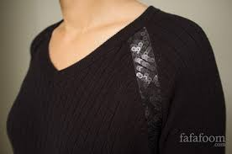
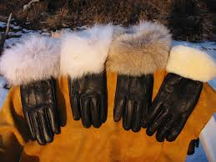
Texture: As Embellishment
The above photos show contrasting textures in garments. The garment is constructed out of a primary fabric, while embellishment is added with a secondary fabric.

Slide 19
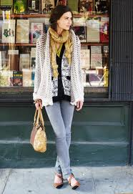
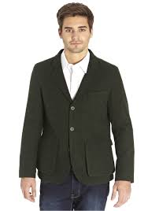
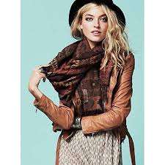
Texture: In Outfits
The above photos show contrasting textures in outfits. Mixing and matching various textures creates interest in one’s look.

Slide 20
Element of Design: Colour
Colour is the most important element in fashion design, and there are many different colour schemes that work together. A quilter’s wheel shows compatible colour combinations and can be useful when trying to decide if certain wardrobe items go together.
Neutral colours, in fashion, can be worn with any other colour, making them good colours for wardrobe-building. Colours such as beige, black, grey, brown, and white are neutral colours because of their versatility to match with other colours.
In fashion, colours can be described as warm or cool. Warm colours are made with orange, red, yellow and combinations of them all. As the name indicates, they tend to make you think of sunlight and heat. Warm colours advance (or seem bigger in space), so they give the illusion of enlarging size. Cool colours such as blue, green and light purple have the ability to calm and soothe. Where warm colors remind us of heat and sunshine, cool colors remind us of water and sky. Unlike warm colors, cool colors look as though they recede (or seem smaller in space), giving the illusion of reducing size.

Slide 21


Colour: Colour Charts
Warm & Cool Colours
Neutral Colours

Slide 22
Principle of Design: Balance
Balance in fashion design can be achieved with the use of features such as seams, hemlines, and necklines. Symmetrical balance occurs when there is consistence in the element of a garment. For example, a straight hemline has symmetrical balance. Most clothing is created with symmetrical balance. Asymmetrical balance can be effective too. For example, a skirt that has a deliberately jagged, uneven hemline has asymmetrical balance. Balance in fashion follows trends. For example, bell-bottoms that have asymmetrical balance between the top and bottom of the pants fall in and out of fashion; the same is true of asymmetrical necklines. Asymmetrical balance is more complex and trickier to achieve than symmetrical balance. For example, a one-shoulder gown might look interesting with its asymmetrical neckline, but a jacket with one lapel larger than the other would just look bad.

Slide 23





Principle of Design: Balance
Symmetrical balance is well illustrated by the trees in the above photo. See how balance appears in the photo of the dress below. The left and right sides of the front are mirror images of each other. Same with the left and right side of the back.
These photos show asymmetrical balance in neckline and/or hemline.

Slide 24
Principle of Design: Proportion
Size and scale are important aspects of proportion. Proportion means the size of a part in relation to the size of the whole. When considering bodies, it would be unusual to have a head that is bigger than the torso. The same goes with garments. It would be unusual to have sleeves which are bigger than the whole outfit. Proportion in fashion design is the principle that says various components of a garment or accessory look good together (i.e. with balanced size and scale). To be pleasing, most fashions are made with balanced proportions to bring out the natural shape of the body.
When choosing outfits, proportion is important when dressing to try to achieve certain effects, and many fashion tips are based on this design principle. For example, a short person (who wants to look taller) would avoid wide, baggy pants. A tall person (who wants to look shorter) would avoid very long, skinny jeans. Sometimes people who are small avoid large pieces of jewellry, while tall people avoid small pieces. What other fashion tips can you think of?
Of course, not all outfits are proportionate, and designers often challenge this principle – for better or worse, depending on your taste. Some people like following proportion norms, while others enjoy breaking them.

Slide 25




Principle of Design: Proportion
These fashions all challenge the design norms of propotion.
What fashion suggestions can you think of that would follow the proportion principle?

Slide 26
Principle of Design: Rhythm
Humans’ eyes are designed to move. Rhythm is a fashion principle that invites the observer’s eye to move over a garment. The following techniques create rhythm:
Repetition – repeating lines, shapes, colours, or textures
Gradation – increasing or decreasing lines, shapes, colours, or textures
Radiation – creating lines or colours emerging from a centre, like petals on a flower

Slide 27








Principle of Design: Rhythm
Look at the fashions. Can you see why each has rhythm?

Slide 28
Principle of Design: Emphasis
Emphasis means the interest is concentrated in a particular part or area of a design. Emphasis in clothing may be achieved with contrasts of colours or textures, lines, or unusual shapes.

Slide 29


Principle of Design: Emphasis
Notice how the contrast of colour provides emphasis to the man’s tie and belt and the woman’s belt and decorative embellishment on her dress.

Slide 30

Principle of Design: Harmony
Harmony depends a lot on personal taste. Harmony means that there is pleasing visual unity of all aspects of a design. It is a summary of all of the other elements and principles of design. It means that all parts of the design look as if they belong. There is no excess variation that could displease or detract from appreciating the entire design or look.
What one person thinks has harmony, another may not.
Do you think this fashion layout has “perfect harmony” as its caption says?

